Slide 2
Introduction
type of supervised learning algorithm used for both regression and classification.
KNN tries to predict the correct class for the test data by calculating the distance between the test data and all the training points.
Select the K number of points which is closet to the test data.
Calculates the probability of the test data belonging to the classes of ‘K’ training data
class holds the highest probability will be selected.

Slide 3
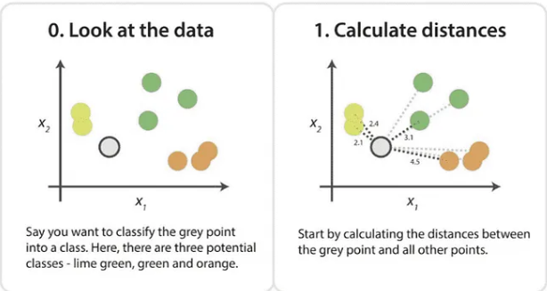

Slide 4
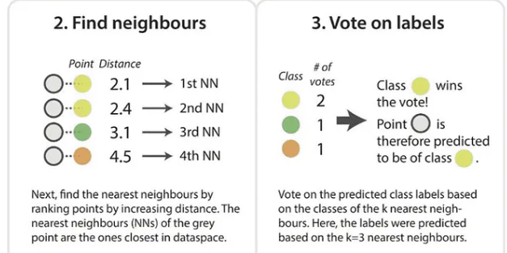

Slide 5
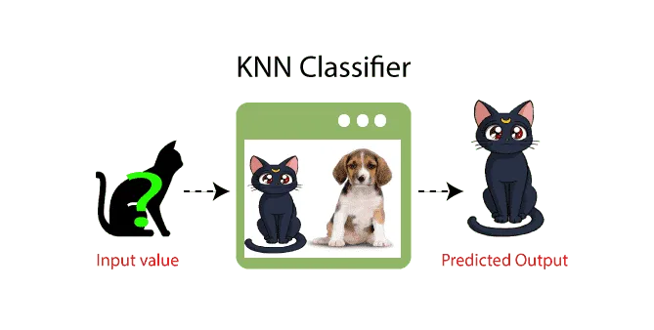

Slide 6
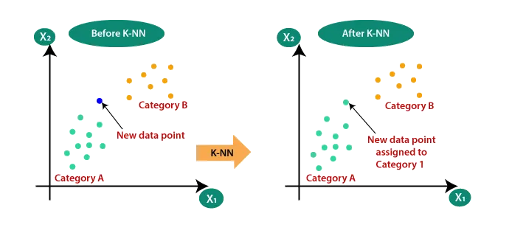
Why do we need a K-NN Algorithm?
Suppose there are two categories Category A and Category B
we have a new data point x1, so this data point will lie in which of these categories.
With the help of K-NN, we can easily identify the category or class of a particular dataset.

Slide 7
How does K-NN work?
Step-1: Select the number K of the neighbors
Step-2: Calculate the Euclidean distance of K number of neighbors
Step-3: Take the K nearest neighbors as per the calculated Euclidean distance.
Step-4: Among these k neighbors, count the number of the data points in each category.
Step-5: Assign the new data points to that category for which the number of the neighbor is maximum.
Step-6: Our model is ready.

Slide 8
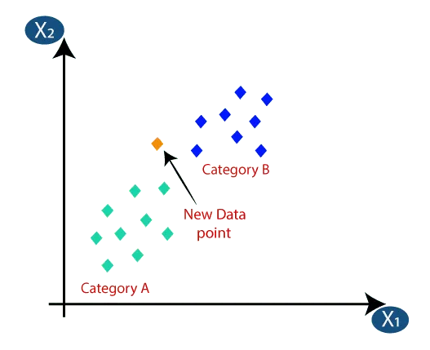
Steps

Slide 9
Steps
Firstly, we will choose the number of neighbors, so we will choose the k=5.
Next, we will calculate the Euclidean distance between the data points.
The Euclidean distance is the distance between two points, which we have already studied in geometry.
It can be calculated as:

Slide 10
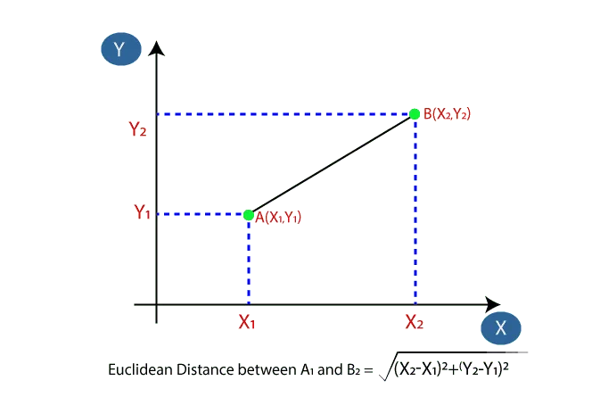
Steps

Slide 11
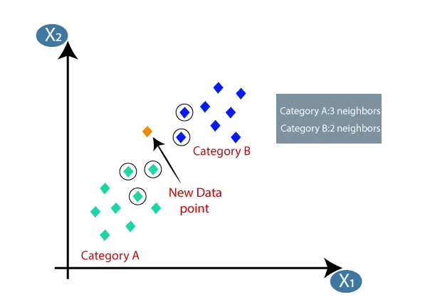
Step
By calculating the Euclidean distance we got the nearest neighbors, as three nearest neighbors in category A and two nearest neighbors in category B. Consider the below image:

Slide 12
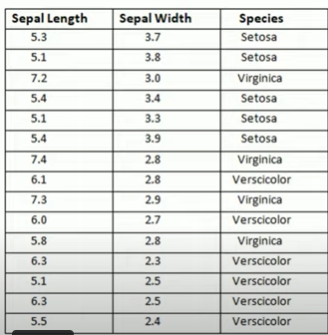
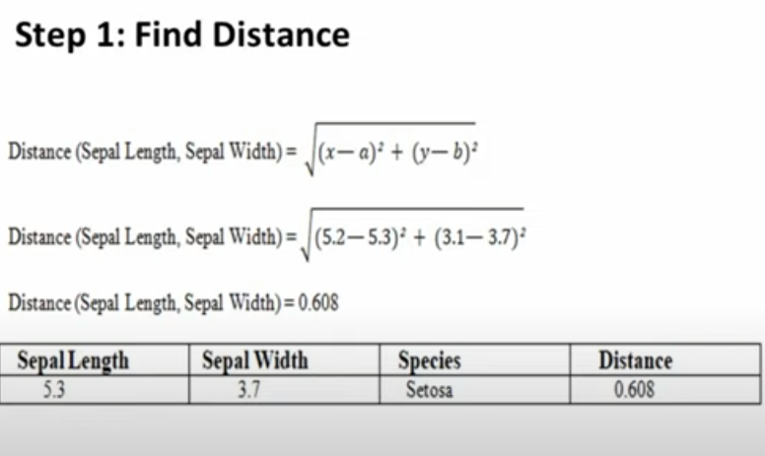

Slide 13
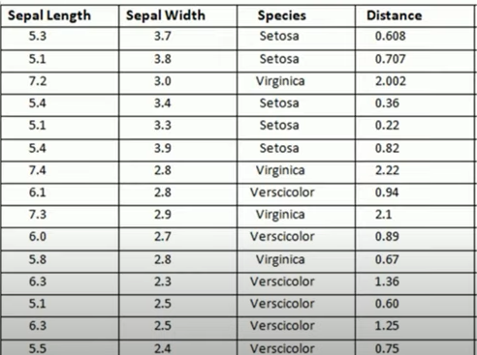

Slide 14
import matplotlib.pyplot as plt x = [4, 5, 10, 4, 3, 11, 14 , 8, 10, 12] y = [21, 19, 24, 17, 16, 25, 24, 22, 21, 21] classes = [0, 0, 1, 0, 0, 1, 1, 0, 1, 1] plt.scatter(x, y, c=classes) plt.show()

Slide 15
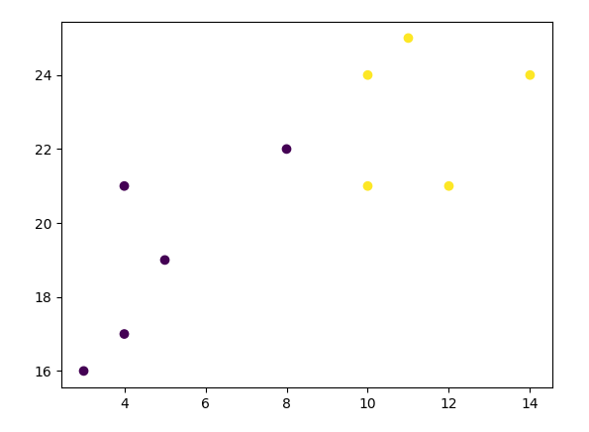

Slide 16
from sklearn.neighbors import KNeighborsClassifier data = list(zip(x, y)) knn = KNeighborsClassifier(n_neighbors=1) knn.fit(data, classes)
new_x = 8 new_y = 21 new_point = [(new_x, new_y)] prediction = knn.predict(new_point) plt.scatter(x + [new_x], y + [new_y], c=classes + [prediction[0]]) plt.text(x=new_x-1.7, y=new_y-0.7, s=f"new point, class: {prediction[0]}") plt.show()

Slide 17
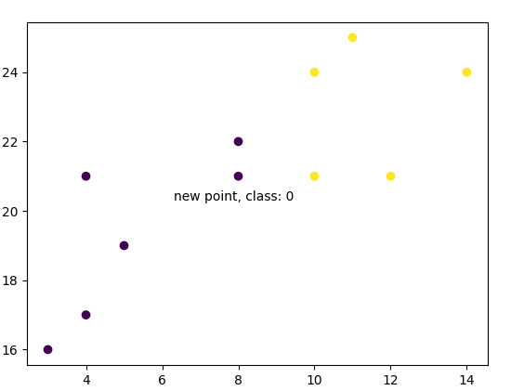

Slide 18
knn = KNeighborsClassifier(n_neighbors=5) knn.fit(data, classes) prediction = knn.predict(new_point) plt.scatter(x + [new_x], y + [new_y], c=classes + [prediction[0]]) plt.text(x=new_x-1.7, y=new_y-0.7, s=f"new point, class: {prediction[0]}") plt.show()

Slide 19
